Slide 1
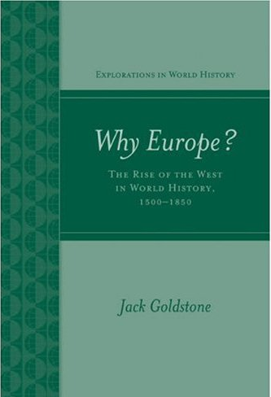

Way of Life & Standards
of Living in the East
Chapter 5
P 120-135
Presenters:
何禾
林若瑄
李勵佩
吳楚茵
賴榆潔

Slide 2
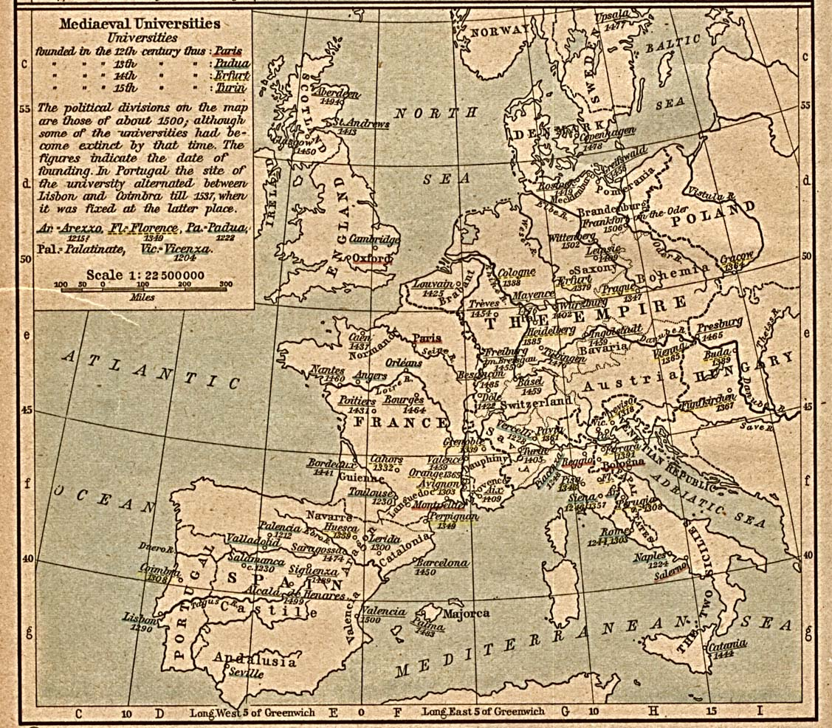
INTRODUCTION
Many of the stories about the rise of the West seem to parallel this one:
In the past, peasants were so poor and so heavily exploited that they had nothing and were starving, always, until the advent of the modern world.
In fact, these are all cyclical.

Slide 3
What many western scholars have long believed:
Before the development of modern industry, Europeans had become more prosperous than people in other parts of the world.
China and India were becoming overcrowded with masses of people who were desperately poor.
→However, the most recent data show that these
beliefs were mistaken.

Slide 4

CONTENT
Marriage & Family Life
Life Expectancy & Stature
Wages, Incomes & Consumption
City Life & Agricultural Productivity
How Did Agricultural Productivity Grow?
The Industrial Revolution & Real Wages
Conclusion

Slide 5
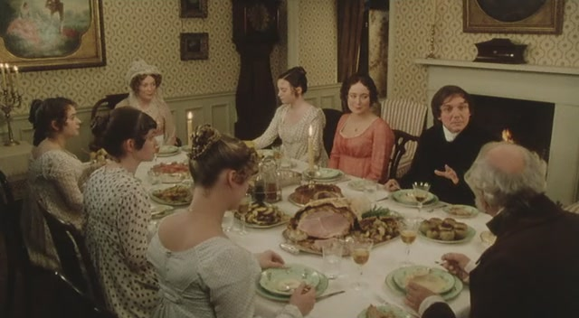
MARRIAGE & FAMILY LIFE
Families were not structured the same way everywhere.
In Britain, the Netherlands, northern France, and Scandinavia
Families were built around new households.
Had to have sufficient savings to start a family of their own.
They often started working in their mid-teens and continued working into their early 20s. Therefore, they usually did not marry until they had reached their early to mid-20s.
Many men and some women never married at all.

Slide 6

In China
Families were built around the combination of
husband and wife and their eldest son and his
wife.
The couple would live with the husband’s
parents.
People could marry fairly early, sometimes as
young as 12 or 13, because they did not have
to start a new household.
The new wife would be under the authority of
her mother-in-law.

Slide 7
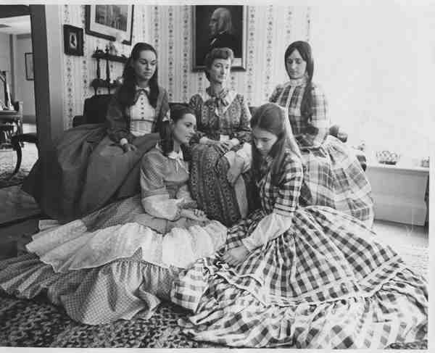
Some scholars of family structure had supposed that these differences explain why some countries were richer than others:
Earlier marriage
More children
Required more resources More workers competing
for work and land
Low wages and productivity

Slide 8

Practices that limited population growth by reducing the total number of children that women were likely to bear:
The northern European family system
Hard for women to marry.
However, once the pair was married, society imposed no further obstacles to childbearing.
Limited fertility by delaying access to marriage
Societies with early ages of marriage
Husbands were often expected to work a certain number of years away from their home village after they were married.
Widows were not allowed to marry again.
Often allowed infanticide(intentional killing of infants) or severe neglect for undesired children.
Limited fertility within marriage

Slide 9

The European and Asian family systems, though different, produced similar levels of population growth.
As a result, we cannot say that differences in marriage patterns or rates of population growth were responsible for differences in living standards across Eurasia in the sixteenth, seventeenth, or eighteenth centuries.

Slide 10

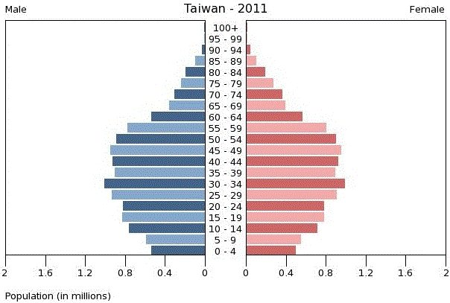
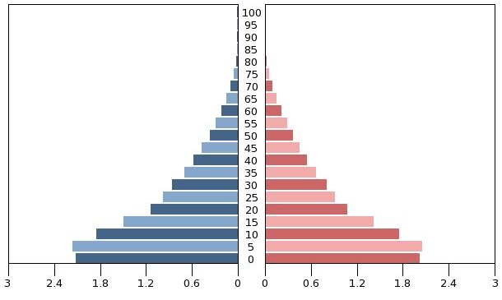
LIFE EXPECTANCY
What we have in mind…
Europe
Asia
In fact…
Europe
Asia

Slide 11

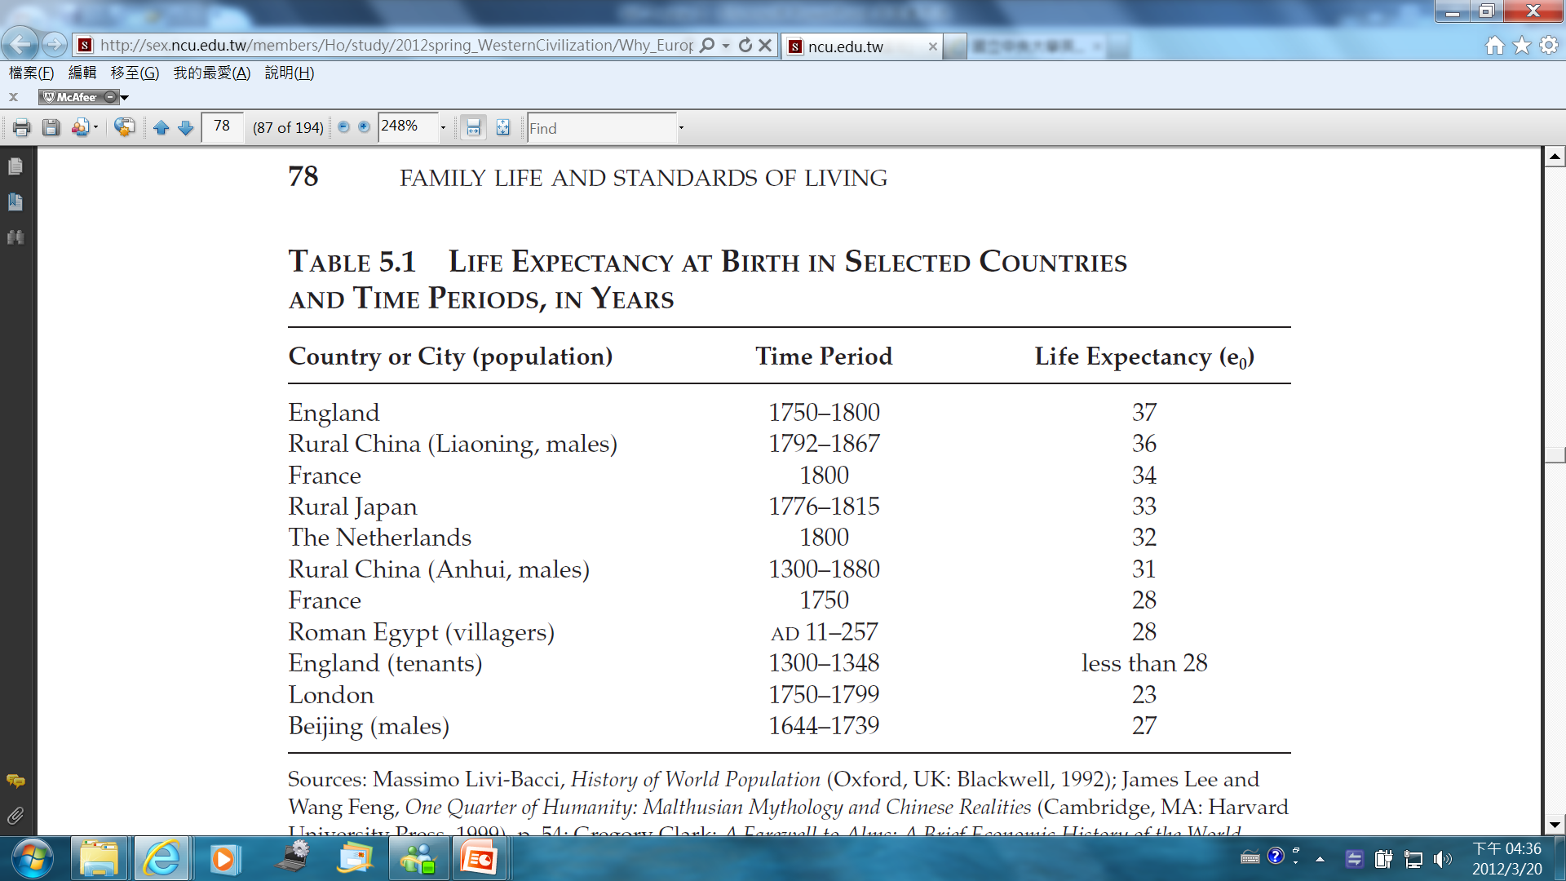
Life Expectancy at Birth in Selected
Countries & Time Periods, in Years
79.4
73
76.4
82.6
79.8
73
76.4
71.3
79.4
79.4
73
(P78)
Life Expectancy 2010 ( List by the United Nations )

Slide 12
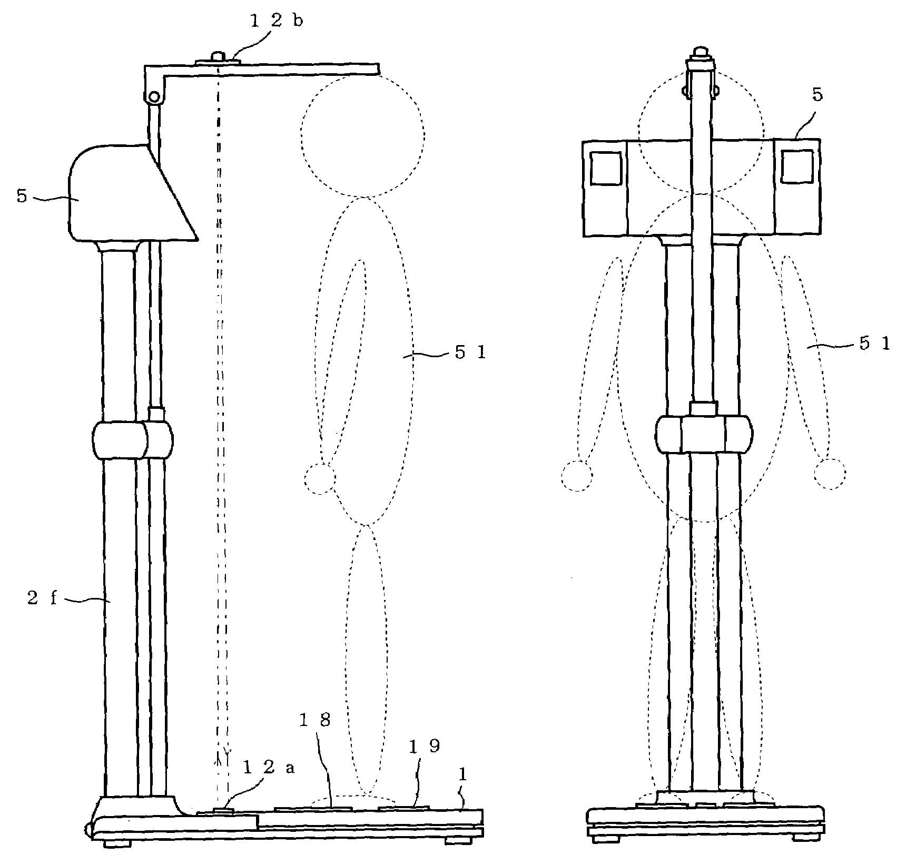


STATURE
What we have in mind…
Europeans
Asians

Slide 13
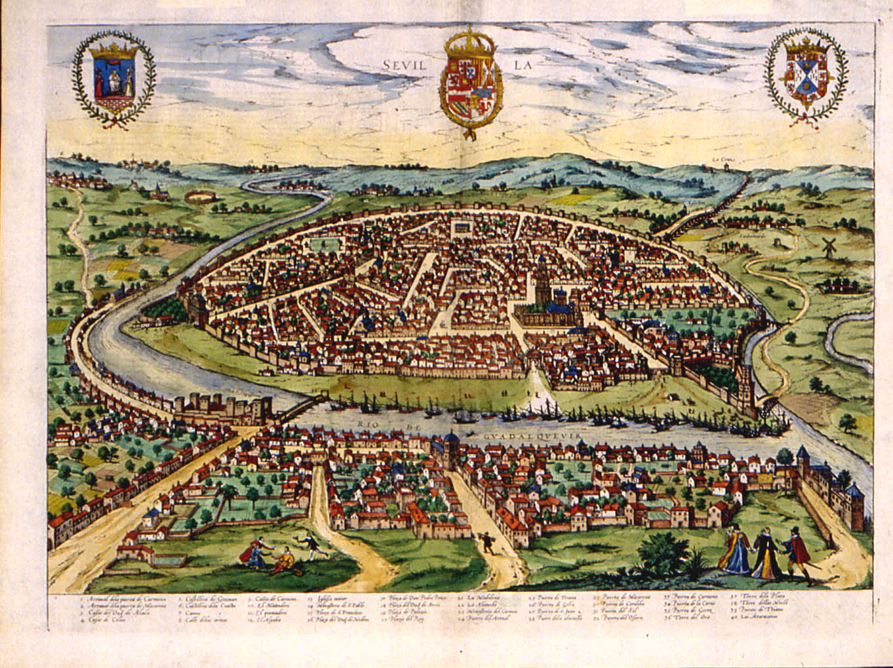

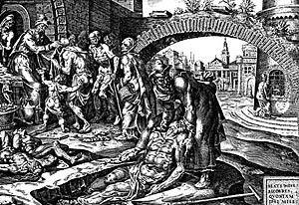
In fact…
‧ Why people living in cities
were shorter:
1.Wage Labor
2.Disease
3.Trade
(P79, paragraph 2)

Slide 14


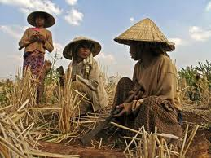
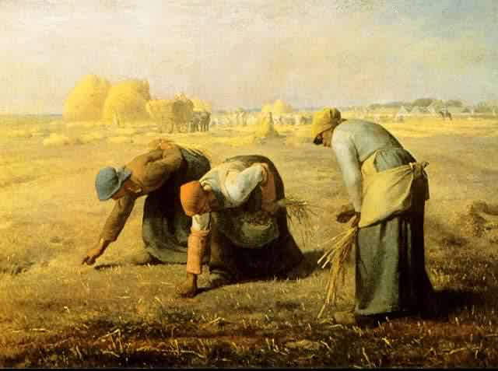
Wages, Incomes, and Consumption
What we have in mind…
Europeans
Asians
In fact…
Europeans
Asians

Slide 15

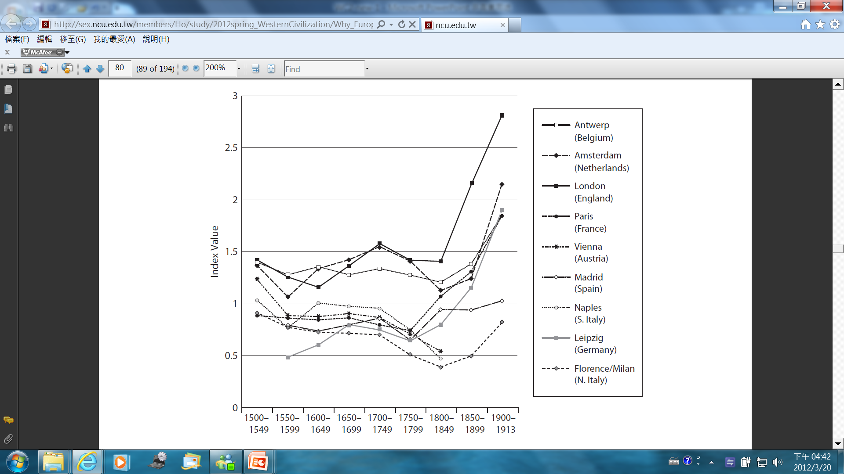
Real Wages of Laborers in European Cities
(P80)

Slide 16
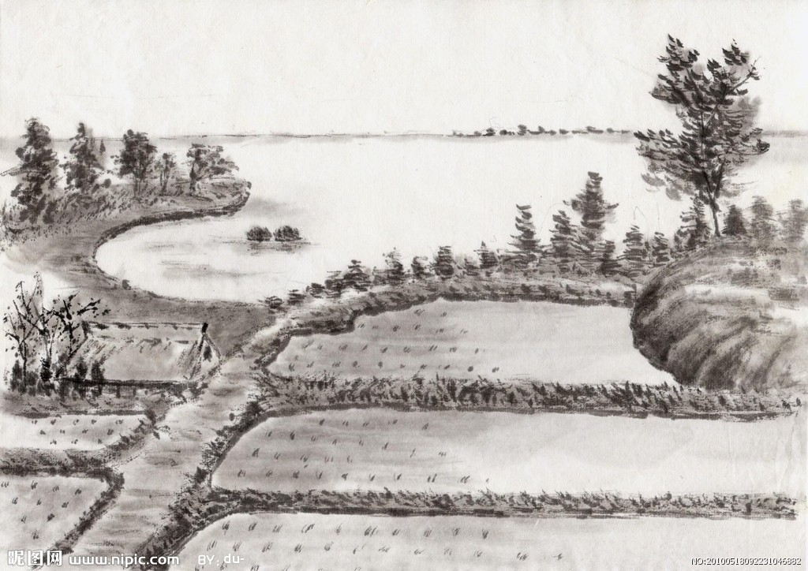
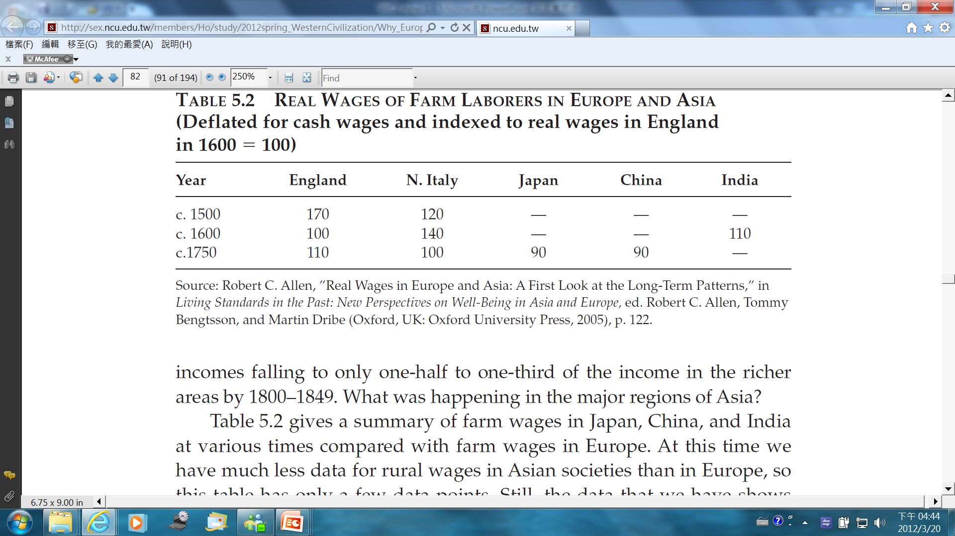
Real Wages of Farm Laborers in Europe & Asia
c. 2011 35,974 30,165 34,362 8,394 3,703
GDP (per capita) List by the IMF
(P82)

Slide 17
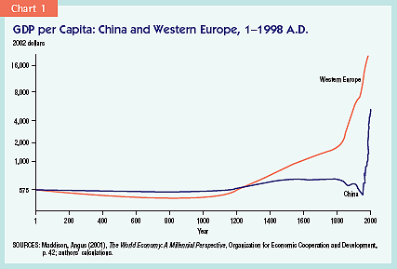
Real Wages of Laborers in European Cities

Slide 18
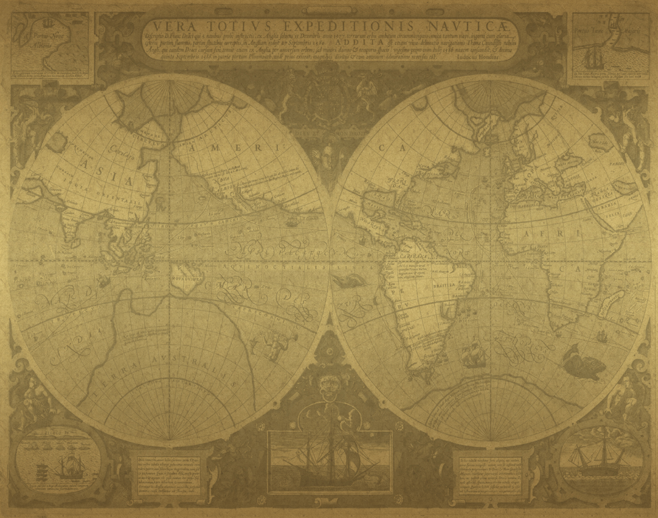

To sum up…
WE WERE NOT SO DIFFERENT!!!

Slide 19

City and Country
In premodern times, the contrast of city and country was not quite different. (P83,paragraph1,line4)
Cites ands the countryside were connected by mutual need. (P83,paragraph2,line1)
City
Country
Luxuries, decorative or manufactured items
Additional output of food and raw materials

Slide 20
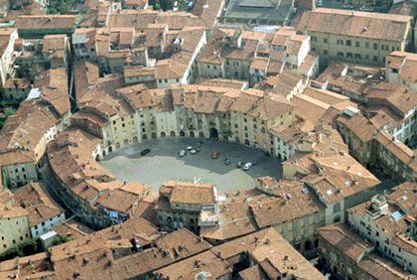
Elements to Form a City
(p 83, last paragraph)
Additional output of rural workers, that is,
agricultural productivity
→ measured by “output per labor produces”
Extensive networks of trade
Vast transportation system
Major civilizations of Asia existed at a
relatively early date.

Slide 21
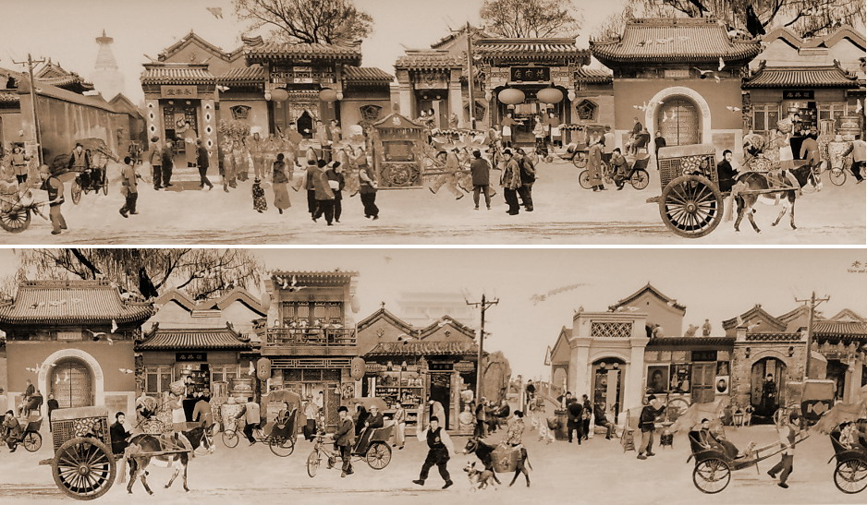
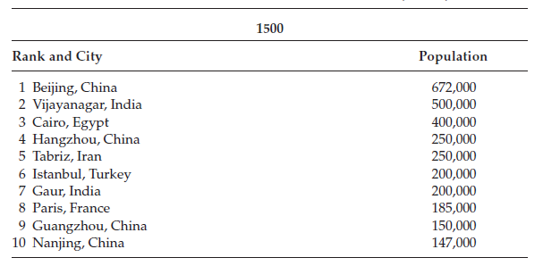
P.84
Firstly, Asia completely dominates the list .

Slide 22
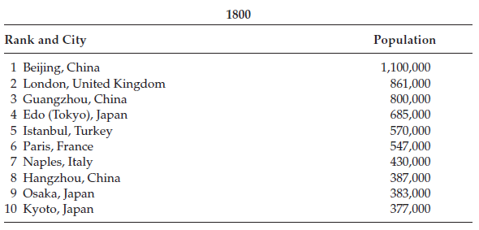

Asia still dominates, but three European cities pop out !

Slide 23
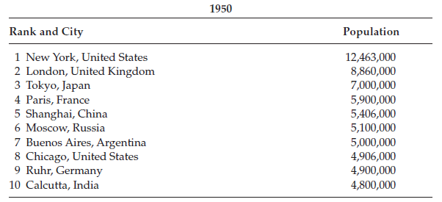
Most of major Asian cities of the prior charts have gone.
However, this tell us that Europe’s rise came relatively late.

Slide 24


Agricultural Productivity
(p86)
Comparing Figure 5.1 (p80)and 5.2 (p86),
we find that the countries with
the highest level of agricultural productivity in 1700
were also
the countries where
urban wages were highest.
(paragraph5,line4)

Slide 25

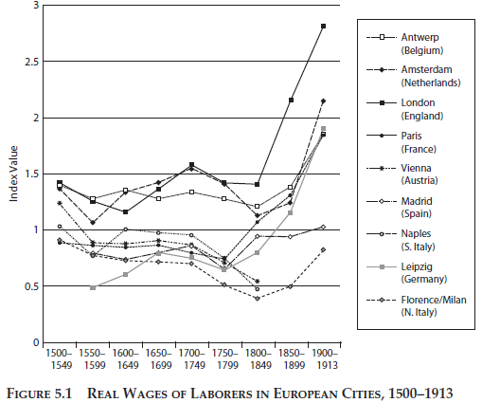
P 80

Slide 26
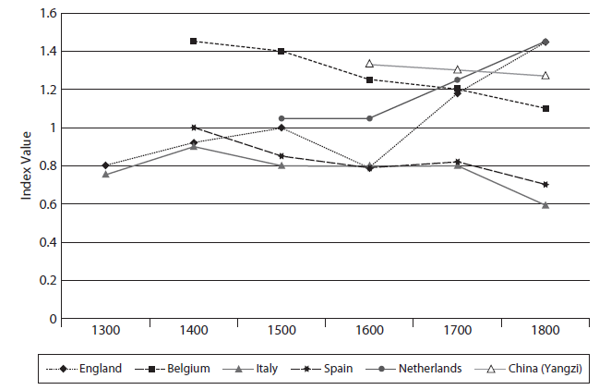
P 86

Slide 27

Examples:
Belgium starting at a very high level at Middle Ages, and slowly declined.
England caught up with Belgium and the Netherlands by 1700, and grow rapidly after 1850.
China had higher level of labor productivity but stable !
1. it had the largest city before 1800.
2. not poor but relatively rich
3. travelers’ tales that stress the wealth and prosperity of Asia

Slide 28
In a word,
the figure 5.2 tells us that
the differences within Europe
is greater than
that between Europe and China.

Slide 29

How Did Agricultural Productivity Grow?
Why did some countries have higher agricultural productivity than others?
soil, weather, and water
Populations grew
Intensive worked land
Notes:
Part of reasons were soil, weather and water, but when populations grew, intensive worked land was more important

Slide 30
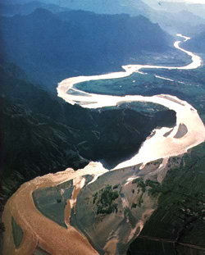
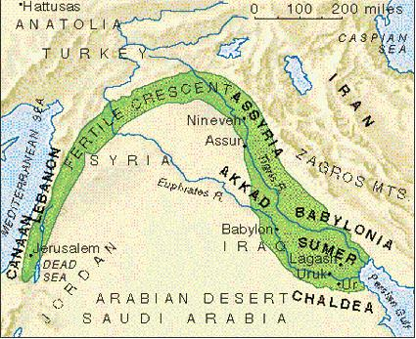
China Yellow River
The middle Eastern region of Mesopotamia
Fertile Crescent
(肥沃月灣)

Slide 31
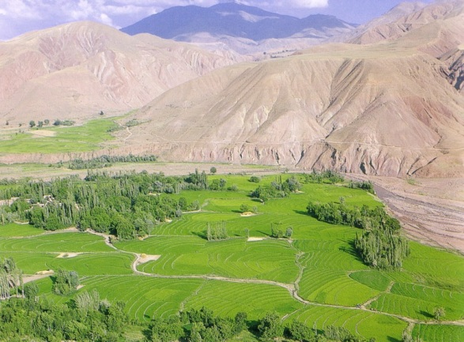
Mesopotamia

Slide 32
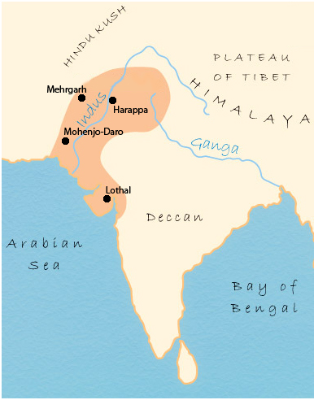
The Indus River valley in India
Indus River
(梧桐河)

Slide 33
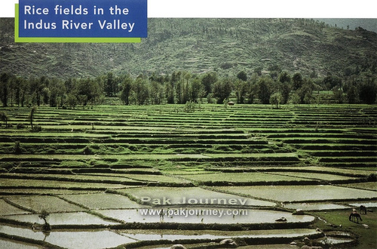

Slide 34
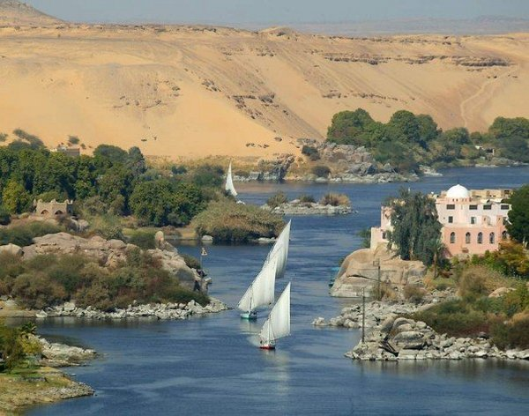
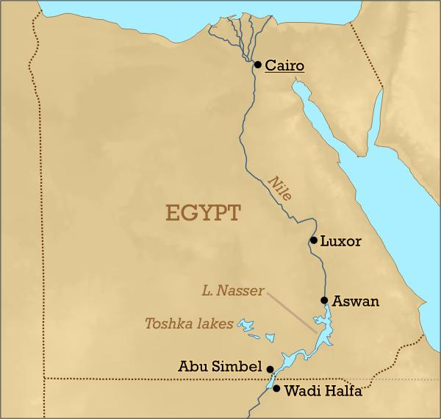
Nile River Valley in Egypt
Nile

Slide 35

Europe
Three-field system
Main grain crops 穀類
Fallow or rough grazing
(休耕) (放牧)
Wheat, barley, rye, oats
Non-grain crop
Peas, beans, clover
Notes:
In Europe, since the times of Charlemagne, there was a transition from a two-field crop rotation to a three-field crop rotation.

Slide 36
Result……
Much higher yields of grain

Slide 37
But……
Egypt was the breadbasket of the ancient Mediterranean, and India and China were able to build large civilizations while Europe was still developing its first city-states.
(歐洲尚處於古希臘城邦時期時，中國、印度早發展得嚇嚇叫了！)
(p.88,line25)

Slide 38
Because……
not
Europe’s three-field was very intensive!
(p.88 line22)
Need to find another way to increase the output of animal feed and manure, then more land could be fertilized and planted in grain.

Slide 39


Four-field rotation
Alfalfa 苜蓿
Turnip
蕪菁
Animal feeds
Grain
turnips, alfalfa
wheat
nitrogen-fixing crops
固氮作物
Grain
clover, beans, peas
barley

Slide 40


The new system could be adopted only near major cities that provided such markets.(p.89 line 6)
expensive to convert!
Wine production
→ add cash but
not more grain
Notes:
Frist place began was in Flanders, they sought to fortify their lands against Viking. People gather to fortress-towns for protection and made a living by weaving raw wool. Up to then, large workers needed to be fed, Belgian farmers began converting to four-field rotation and achieved the highest agricultural productivity in Europe.
But for most of continental Europe, like Alpine regions(Austria) or Mediterranean regions(Spain and Italy), the climate was too dry or too far away from main markets. (按一下 講完 再按一下)

Slide 41

Adding 250 million(2.5億)
Improve and intensify the technology by using new fertilizers and crop rotations.
(p.90 line 1)
China pioneered the large-scale recycling of waste products.
Mashed seeds,
beans, husks
Soy sauce(醬油)
Bean curd(豆腐)
Cooking oil
bean cake
壓榨加工
製成
Notes:
Europe was increasing its agricultural productivity, how about China and the rest of Asia? (按一下) China’s population increased from 100 million to 350 million.
(動畫跑完後) easy-to-use fertilizer and the early-ripening of rice which allowed two crops in a single season(一年兩收成)!

Slide 42
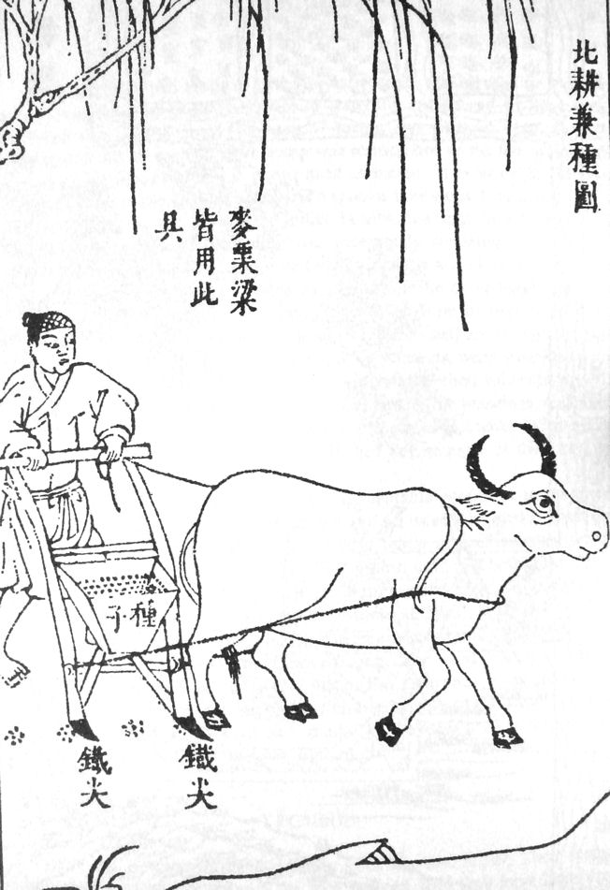
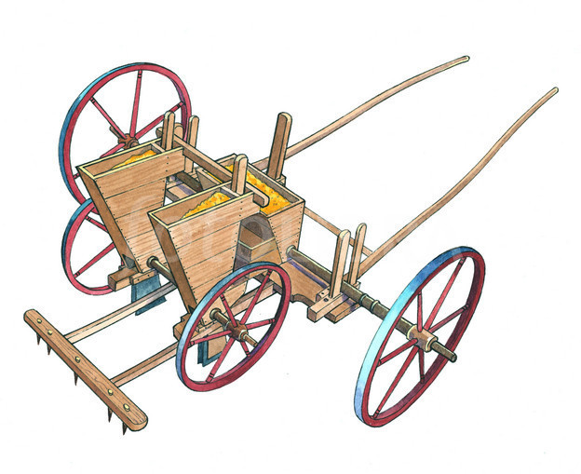
Refined techniques for planting and irrigating
seed drill
water buffalo

Slide 43
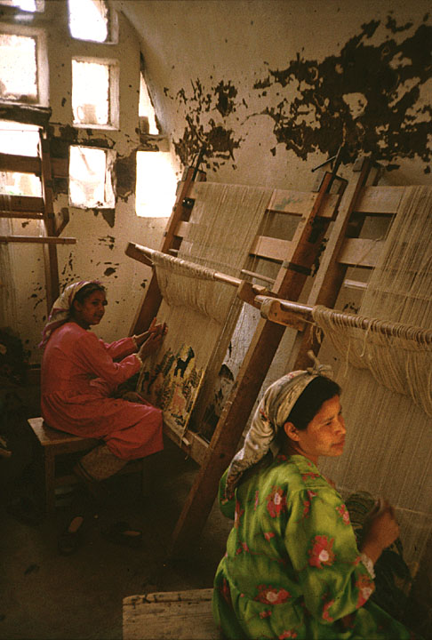
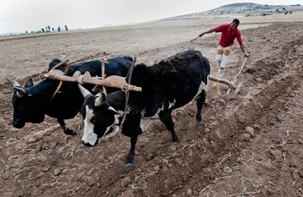
Two sayings (p.90 line 41)
“one family, 10 mou”(十畝一家)
“man plows, woman weaves”(男耕女織)
Notes:
Refined techniques save human labor. Female labor could be released from farming and summed up the new farming system with two sayings(按一下)
“one family, 10 mou” mean an acre could support a family

Slide 44
In short……
Techniques for
intensifying agricultural
agricultural productivity
Living standards
Notes:
In short, from 16th to 19th century……(唸PPT上面 )

Slide 45
But!
Why did real wages in London suddenly shoot up after 1850?
Why had real wages in northern Europe risen to unseen levels while real wages in Asia declined largely after 1800?

Slide 46
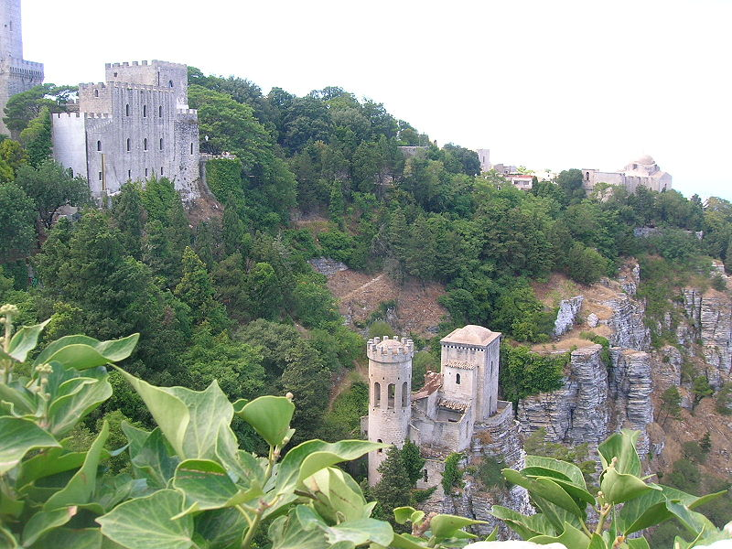
The Industrial Revolution & Wages
The Period: From 1500~1750
Material life was composed of agriculture and trade.
The manufacturing industry was still minority.
Land owners and merchandisers were wealthier.

Slide 47

Farming
Farming played a dominant role.
While farming wasn’t the only factor leading to modernization.

Slide 48
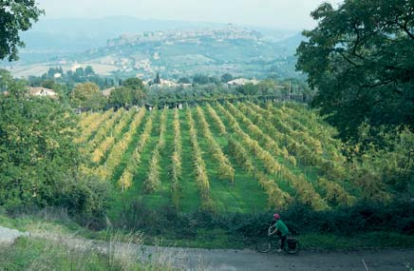
The Limits
of Agriculture
Real wages generally swing within a stable range.
Due to the balance between agricultural productivity and population growth.

Slide 49
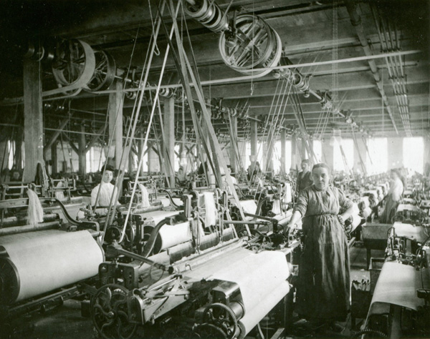
Why Did Wages Rise In The Northern England?
Reason: The northern and midlands regions of England were the sites of booming new textile and metalworking factories.

Slide 50
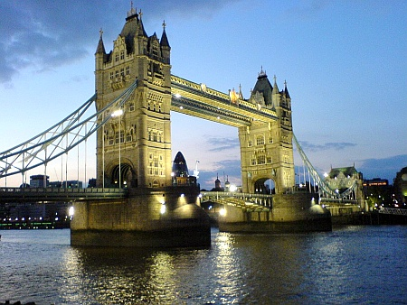
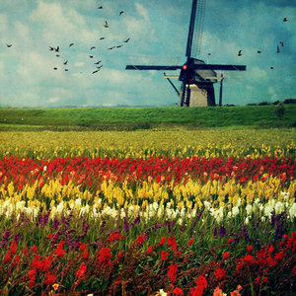
Compared with England and Netherlands
England: produce mainly in manufacturing and transportation.
Netherland: conventional agricultural and trading economy.

Slide 51
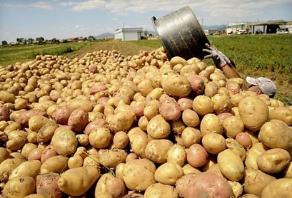
The Vulnerability of the Agriculture Economy
A large-scale monoculture brings about reductions of biological diversity, and increased its risks in the face of blight.
EX: The spread of potato farming in Ireland and western Germany

Slide 52
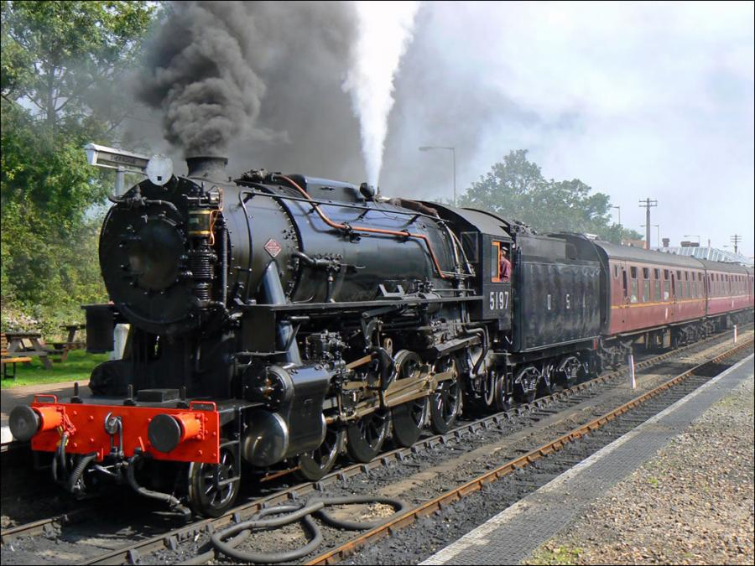
The Rise of Industry
A source of mass employment.
Basically change people’s economic life.
Till 1850s did wage growth start to accelerate.
The spread of industry was a slow-motion revolution.

Slide 53
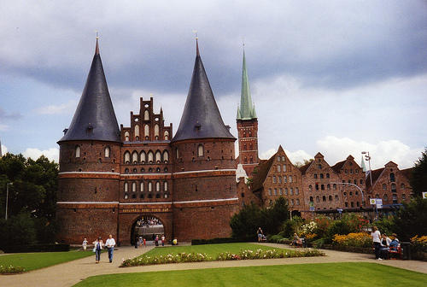
CONCLUSION
(P94)
There is no “always”.
No preindustrial societies were always poor, nor
always well-off.
Much changes were merely cyclical fluctuations;
the long-term average standard of living
changed little for centuries.
The existence of a rich Europe and a poor Asia is
a relatively recent phenomenon.
The divergence of “the West” and “the East” is
strongly rooted in domestic productivity.

Slide 54

Question
“….the richest European nations didn’t become rich because they took more treasure from other parts of the world or because they had empires or slavery….” Is true? Or Eurocentrism?
2. 亞洲和歐洲生育率?

Slide 55




Slide 56

The End~
Thank You!!

